Slide 1
PART 2
TRANSMISSION MEDIA
CSE 403 Computer Networks

Slide 2
Basic Idea
Encode data as energy and transmit energy
Decode energy at destination back into data
Energy can be electrical, light, radio, sound, ...
Each form of energy has different properties and requirements for transmission
CSE 403 Computer Networks

Slide 3
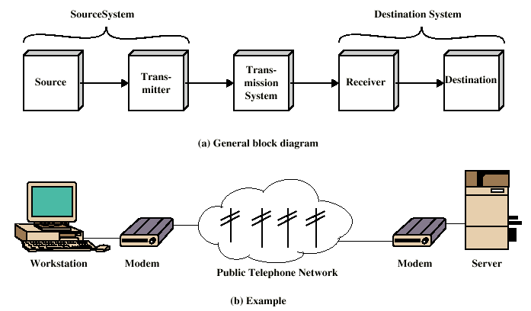
Transmission
Simplified Communications Model
CSE 403 Computer Networks

Slide 4
Transmission media
Transmitted energy is carried through some sort of medium
Transmitter encodes data as energy and transmits energy through medium
Requires special hardware for data encoding
Requires hardware connection to transmission medium
CSE 403 Computer Networks

Slide 5
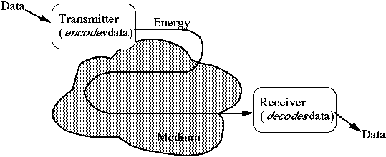
Transmission media (cont’d)
Media can be copper, glass, air, ...
CSE 403 Computer Networks

Slide 6
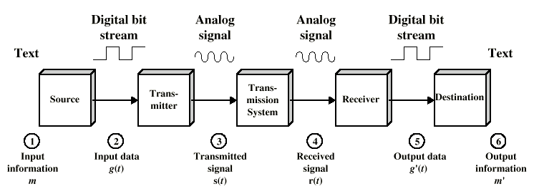
Data Communications
Simplified Data Communications Model
CSE 403 Computer Networks

Slide 7
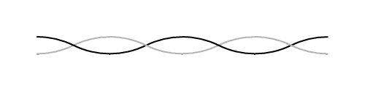
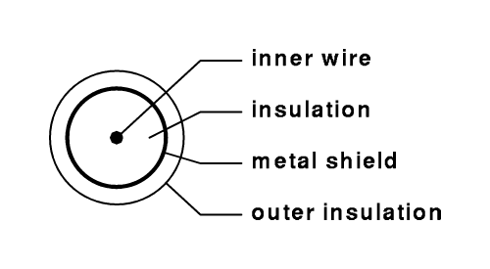
Copper wires
Twisted pair uses two wires
Coaxial cable includes shield for improved performance
CSE 403 Computer Networks

Slide 8
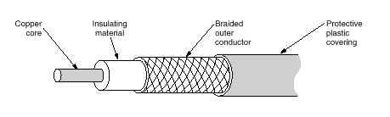
Co-axial Cable
CSE 403 Computer Networks

Slide 9
Glass fibers
Thin glass fiber carries light with encoded data
Plastic jacket allows fiber to bend (some!) without breaking
Fiber is very clear and designed to reflect light internally for efficient transmission
CSE 403 Computer Networks

Slide 10

Glass fibers (cont’d)
Light emitting diode (LED) or laser injects light into fiber
Light sensitive receiver at other end translates light back into data
CSE 403 Computer Networks

Slide 11
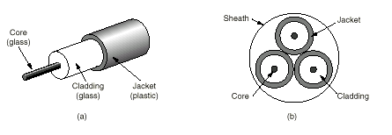
Fiber Cable
CSE 403 Computer Networks

Slide 12
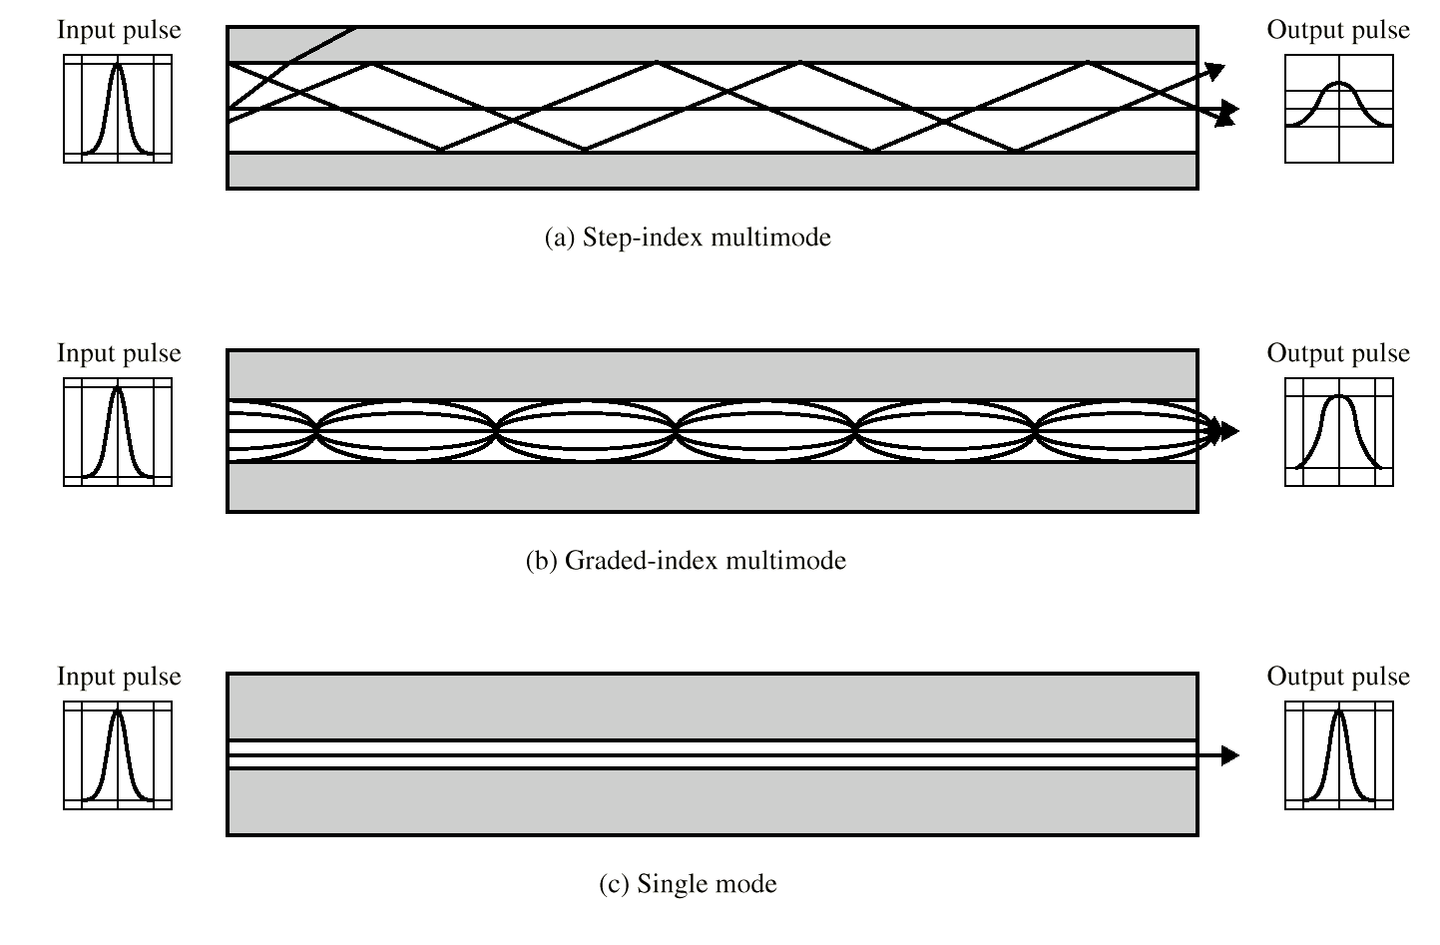
Optical Fiber Transmission Modes
CSE 403 Computer Networks

Slide 13
Transmission Characteristics of Guided Media
Frequency Range
Typical Attenuation
Typical Delay
Repeater Spacing
Twisted pair (with loading)
0 to 3.5 kHz
0.2 dB/km @ 1 kHz
50 µs/km
2 km
Twisted pairs (multi-pair cables)
0 to 1 MHz
0.7 dB/km @ 1 kHz
5 µs/km
2 km
Coaxial cable
0 to 500 MHz
7 dB/km @ 10 MHz
4 µs/km
1 to 9 km
Optical fiber
186 to 370 THz
0.2 to 0.5 dB/km
5 µs/km
40 km

Slide 14
Radio
Data transmitted using radio waves
Energy travels through the air rather than copper or glass
Conceptually similar to radio, TV, cellular phones
Can travel through walls and through an entire building
CSE 403 Computer Networks

Slide 15
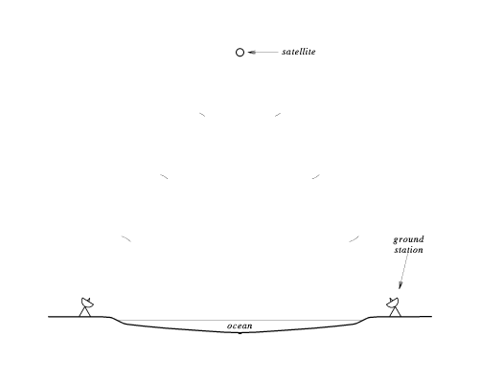
Radio (cont’d)
Can be long distance or short distance
  Long distance with satellite relay
  Short distance - wireless computer network
CSE 403 Computer Networks

Slide 16
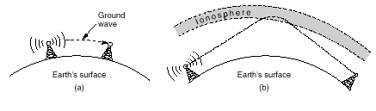
Radio (cont’d)
(a) In the VLF, VF and MF bands, radio waves follow the curvature of the earth, (b) In the HF, they bounce off the ionosphere.
CSE 403 Computer Networks

Slide 17
Microwave
High frequency radio waves
Unidirectional, for point-to-point communication
Antennas mounted on towers relay transmitted data
CSE 403 Computer Networks

Slide 18
Infrared
Infrared light transmits data through the air
Similar to technology used in TV remote control
Can propagate throughout a room (bouncing off surfaces), but will not penetrate walls
Becoming common in personal digital assistants (PDAs) and portable computers
CSE 403 Computer Networks

Slide 19
Laser
Unidirectional, like microwave
Higher speed than microwave
Uses laser transmitter and photo-sensitive receiver at each end
Point-to-point, typically between buildings
Can be adversely affected by weather
CSE 403 Computer Networks

Slide 20
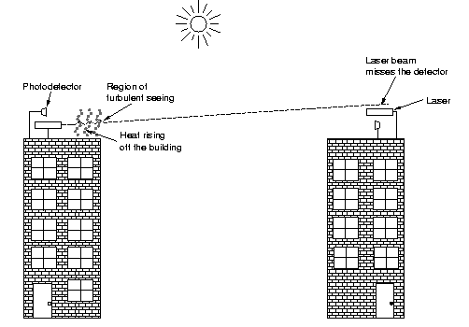
Laser (cont’d)
CSE 403 Computer Networks

Slide 21
Choosing a medium
Copper wire is mature technology, rugged and inexpensive; maximum transmission speed is limited
Glass fiber:
  Higher speed
  More resistant to electro-magnetic interference
  Spans longer distances
  Requires only single fiber
  More expensive; less rugged
CSE 403 Computer Networks

Slide 22
Choosing a medium (cont’d)
Radio and microwave don't require physical connection
Radio and infrared can be used for mobile connections
Laser also does not need physical connection and supports higher speeds
CSE 403 Computer Networks

Slide 23
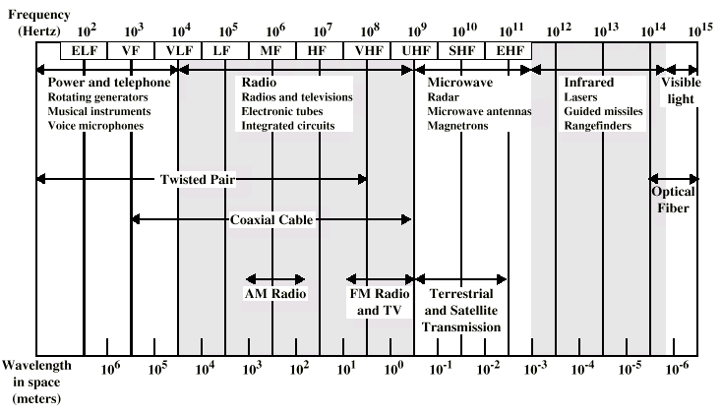
Electromagnetic Spectrum for Telecommunications
CSE 403 Computer Networks

Slide 24
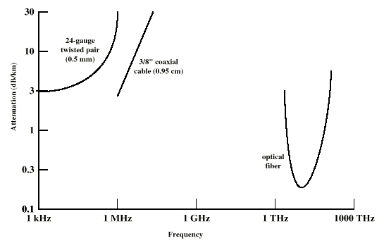
Attenuation to Typical Guided Media
CSE 403 Computer Networks

Slide 25
Media in use at DEÜ
Copper/fiber for long-distance connection to Internet and between campuses
Fiber within and between buildings
Copper within buildings
CSE 403 Computer Networks

